Slide 1

Cyber security

Slide 2


Prersentation by
Suhas .a. baragundi

Slide 3


What you mean by cyber security….?
Cybersecurity is the practice of protecting systems, networks, and programs from digital attacks

Slide 4


前 言
BASIC DETAILS
Bob Thomas is often called the "father of cybersecurity".
In 1971, he created the first computer virus,
called the "Creeper virus",

Slide 5

Introduction
Cybersecurity protects systems from hackers.
This project focuses on detecting unusual login behavior.
Power BI and Python were used for data visualization and predictive modeling.

Slide 6

Dataset Overview
Dataset Name: Cybersecurity Login Data.
Number of Records: 10,000
Key Columns:
User_ID
Timestamp
Login_Status (Success/Failed)
IP Adress
LocationAccess Duration
Dataset Name: Cybersecurity Login Data.
Number of Records: 10,000
Key Columns:
User_ID
Timestamp
Login_Status (Success/Failed)
IP Address
Location
Access Duration

Slide 7

Tools Used
Power BI:
Data visualization and dashboard creation.
Python Libraries:
Pandas (Data Processing)
Seaborn & Matplotlib (Visualization)
Scikit-learn (Linear Regression)

Slide 8
Data Cleaning & Preprocessing
Checked for missing values and handled them.
Converted timestamps into date and hour format.
Filtered failed login attempts for analysis.
Created additional columns for better insights.

Slide 9
Power BI Dashboard
KPIs for failed logins and access duration.
Geo-mapped IP addresses of login attempts.
Bar charts showing login attempts by location.
Time-based login trends analysis.

Slide 10

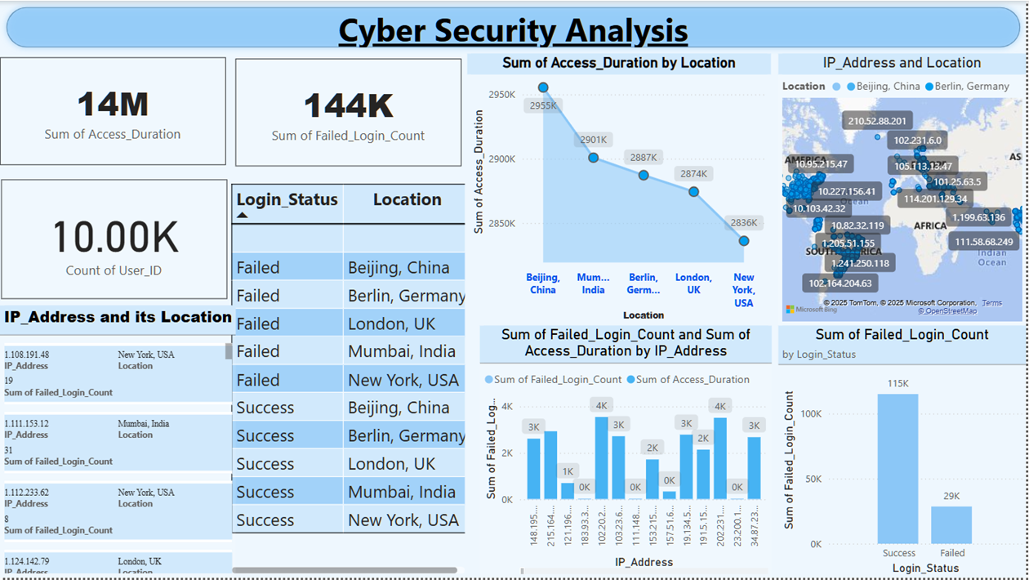

Slide 11
行业PPT模板http://www.1ppt.com/hangye/
Exploratory Data Analysis (EDA) & Linear Regression
Exploratory Data Analysis (EDA):
Failed Logins by Location: Identified high-risk regions.
Login Activity Heatmap: Detected peak hours for failed logins.
User Login Trends: Found patterns in successful vs. failed attempts.
Linear Regression Analysis:
Objective: Predict failed logins based on access duration.
Model Used: Scikit-learn’s Linear Regression.
Findings:
Strong correlation between access duration and failed login attempts.
Regression line shows predicted failed logins over time.

Slide 12
Conclusion & Future Work
2.
1.
Conclusion:
Power BI and Python effectively analyze cybersecurity threats.
Data-driven insights help improve security monitoring.
Future Work
Implement machine learning for anomaly detection.
Automate real-time monitoring using Power BI alerts.

Slide 13
THANK YOU

